Slide 1
Simulation: Before
Stance
Swing
Normal
Foot Drop
Ankle
Knee
Hip
Reference 1
Reference 2
Reference 3

Slide 2
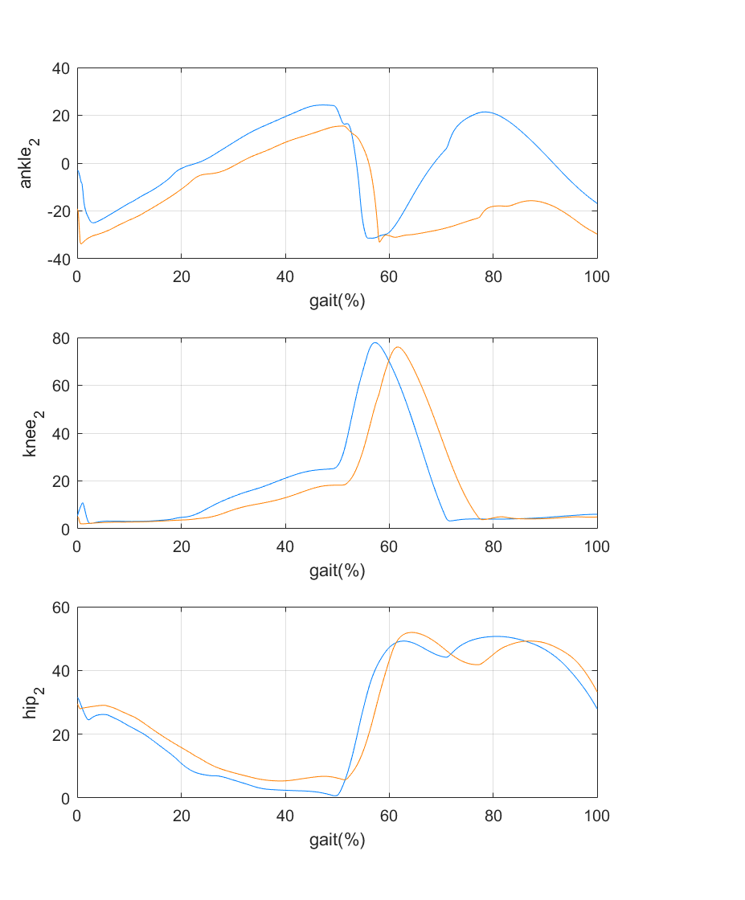
Simulation: New and Better
Normal
Foot Drop
Normal
Disable Tm17
Ankle
Knee
Hip
Reference 1
Reference 2
Reference 3

Slide 3
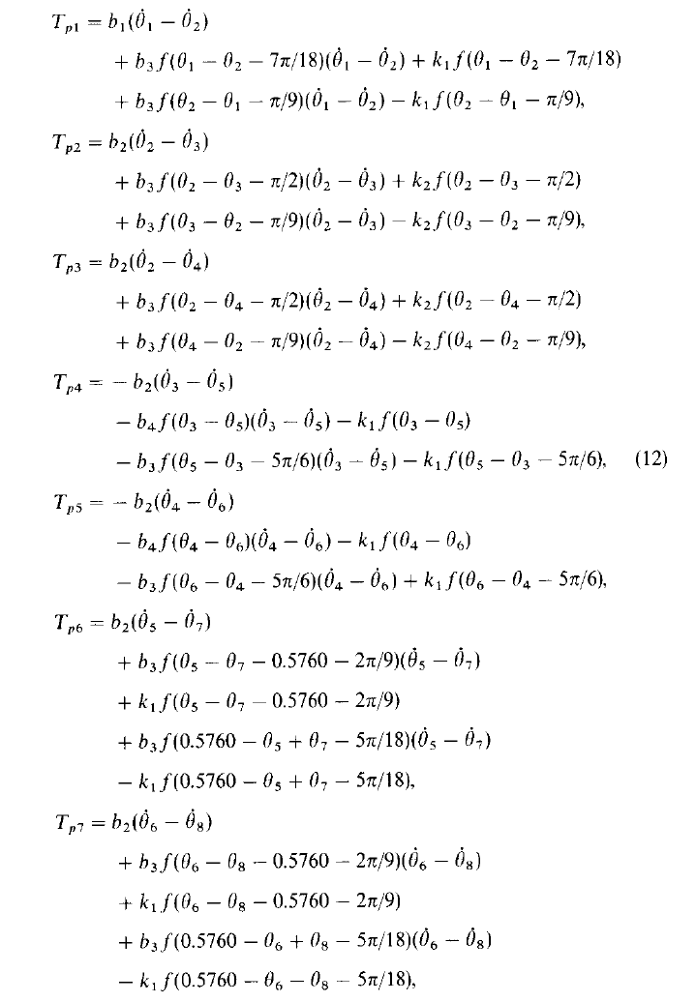
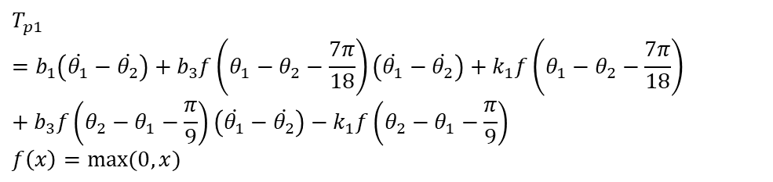
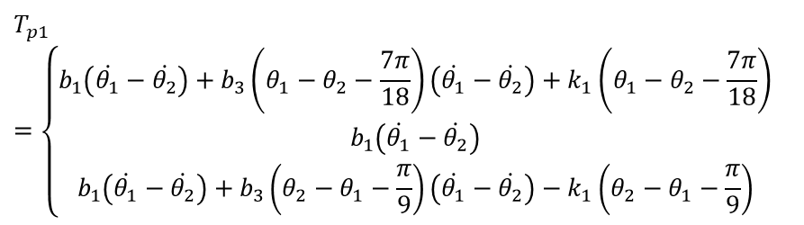
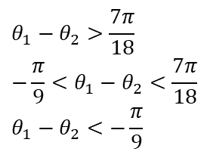
How do I improve it ?
Passive Torque System
Passive Torque 1
$$T_{p1}=b_{1}\left(\dot{θ_{1}}−\dot{θ_{2}}\right)+b_{3}f\left(θ_{1}−θ_{2}−\frac{7π}{18}\right)\left(\dot{θ_{1}}−\dot{θ_{2}}\right)+k_{1}f\left(θ_{1}−θ_{2}−\frac{7π}{18}\right)+b_{3}f\left(θ_{2}−θ_{1}−\frac{π}{9}\right)\left(\dot{θ_{1}}−\dot{θ_{2}}\right)−k_{1}f\left(θ_{2}−θ_{1}−\frac{π}{9}\right)$$
$$f\left(x\right)=max(0,x)⁡$$
$$T_{p1}=\left\{\begin{aligned}b_{1}\left(\dot{θ_{1}}−\dot{θ_{2}}\right)+b_{3}\left(θ_{1}−θ_{2}−\frac{7π}{18}\right)\left(\dot{θ_{1}}−\dot{θ_{2}}\right)+k_{1}\left(θ_{1}−θ_{2}−\frac{7π}{18}\right) \\ b_{1}\left(\dot{θ_{1}}−\dot{θ_{2}}\right) \\ b_{1}\left(\dot{θ_{1}}−\dot{θ_{2}}\right)+b_{3}\left(θ_{2}−θ_{1}−\frac{π}{9}\right)\left(\dot{θ_{1}}−\dot{θ_{2}}\right)−k_{1}\left(θ_{2}−θ_{1}−\frac{π}{9}\right)\end{aligned}\right.$$
$$θ_{1}−θ_{2}>\frac{7π}{18}$$
$$−\frac{π}{9}<θ_{1}−θ_{2}<\frac{7π}{18}$$
$$θ_{1}−θ_{2}<−\frac{π}{9}$$
The function of passive torque is mainly to keep the joint angles within reasonable range
What I do to improve simulation is mainly by changing the range in passive torque function so that the model can walk more like normal gait

Slide 4
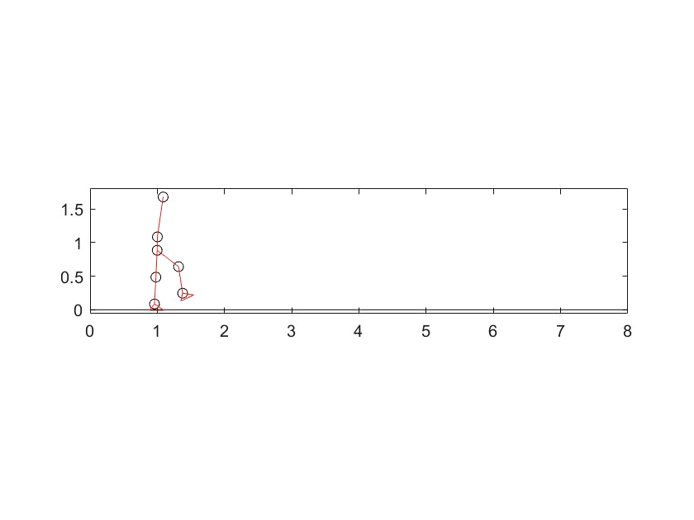
Compare of previous simulation and new simulation
We can see from the video, that the new simulation is better in stability, and does not have the problem of externally rotate the thigh. And all of the joint angles are within reasonable range
Previous
New
It would be better and more clear to watch the video if fast forwarding it

